Slide 1
Graphing a parabola
J.Wilson
Materials.
Graph paper (ie -10 to 10 with the xy tables paper works well)

Slide 2
What is a parabola?

Slide 3
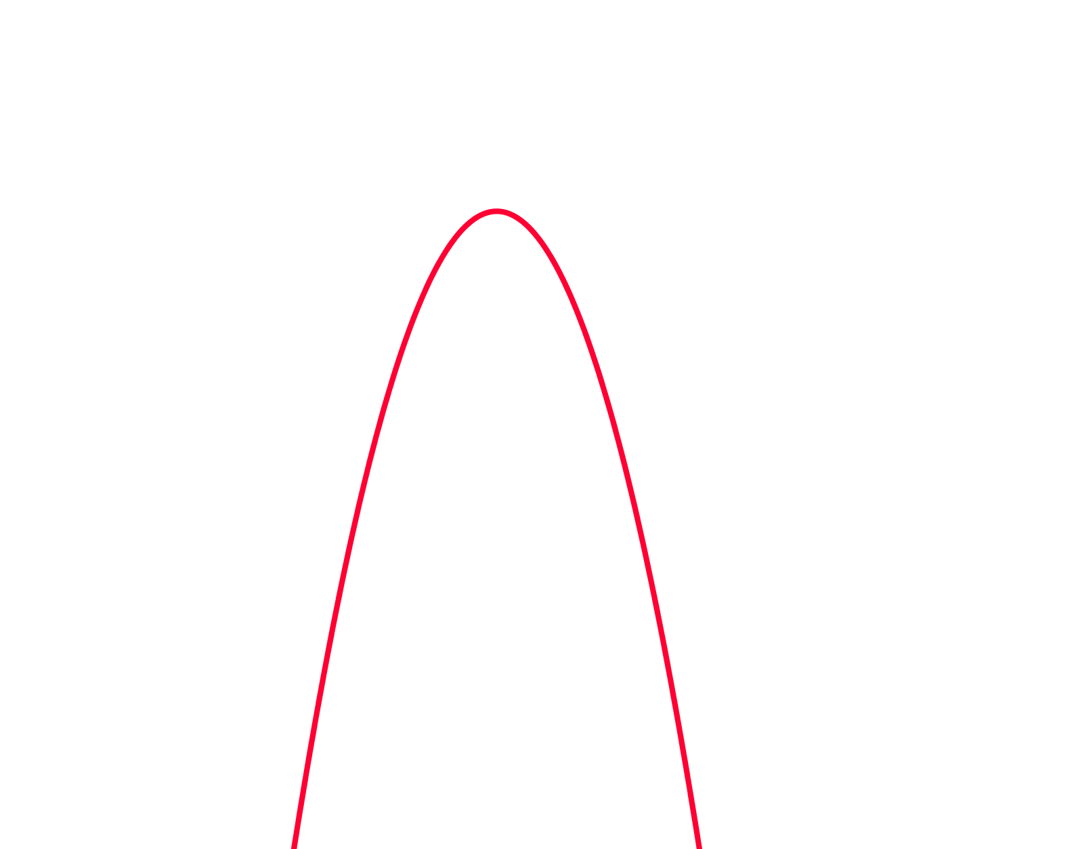
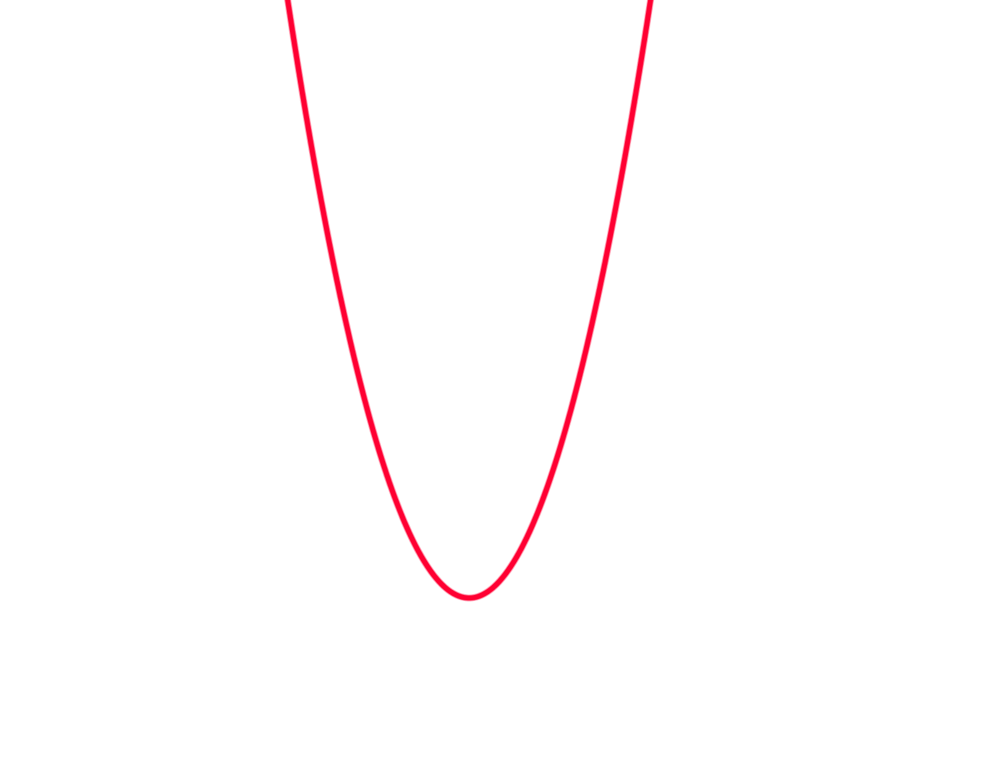
What is a parabola?
This is a positive parabola
This is a negative parabola
Can you think of where you might find a parabola in the real world?

Slide 4
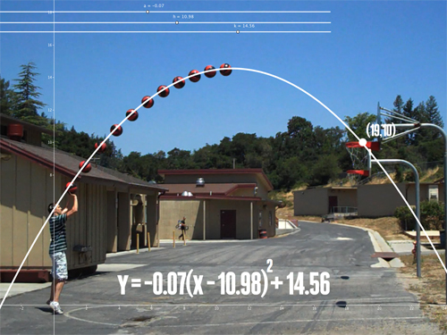

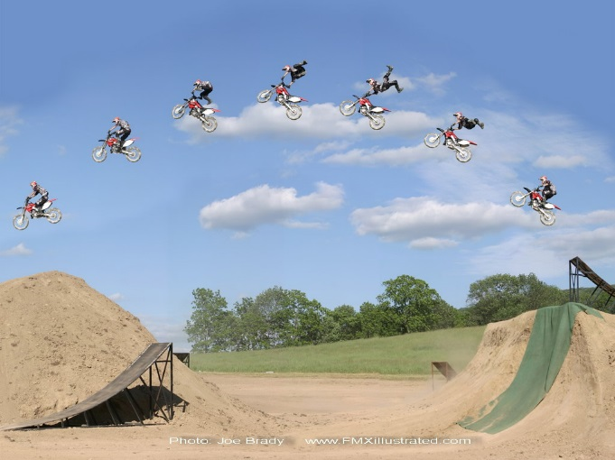
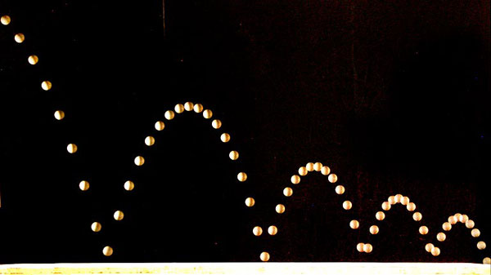
Objects affected by gravity follow a parabolic arc.

Slide 5

Parabolas area also used in arches and architecture

Slide 6
What is a parabola?
This is a positive parabola
This is a negative parabola
Can you think of where you might find a parabola?
Quick write, all the locations you saw a parabola in the video or pictures.

Slide 7
What is a parabola?
This is a positive parabola
This is a negative parabola
Can you think of where you might find a parabola?
Quick write, all the locations you saw a parabola in the video or pictures.
Share your list with the person next to you. Did they have any that you missed?

Slide 8



24
7
30
Date
Topic: Graphing Quadratic Equations
EQ – What information do we need to graph a parabola?
A Quadratic equation has an x² as it’s highest power. When graphed it creates a shape called a parabola.
Examples are y =x² , y = 3x² + 2x + 6, y = -4x² - 5
1. To graph a parabola create a table with x values (I have used x= -3 to x= 3)
2. Substitute the x values into the equation
Eg. Graph the equation y = x²
x | -3 | -2 | -1 | 0 | 1 | 2 | 3
y
9
$$y= x^{2}$$
-3
$$y= {( )}^{2}$$
$$y= 9$$

Slide 9



24
7
30
Date
Topic: Graphing Quadratic Equations
EQ – What information do we need to graph a parabola?
A Quadratic equation has an x² as it’s highest power. When graphed it creates a shape called a parabola.
Examples are y =x² , y = 3x² + 2x + 6, y = -4x² - 5
1. To graph a parabola create a table with x values (often x values from -3 to 3)
2. Substitute the x values into the equation
Eg. Graph the equation y = x²
x | -3 | -2 | -1 | 0 | 1 | 2 | 3
y
9
4
$$y= x^{2}$$
-2
$$y= {( )}^{2}$$
$y=$ 4

Slide 10



24
7
30
Date
Topic: Graphing Quadratic Equations
EQ – What information do we need to graph a parabola?
A Quadratic equation has an x² as it’s highest power. When graphed it creates a shape called a parabola.
Examples are y =x² , y = 3x² + 2x + 6, y = -4x² - 5
1. To graph a parabola create a table with x values (often x values from -3 to 3)
2. Substitute the x values into the equation
Eg. Graph the equation y = x²
x | -3 | -2 | -1 | 0 | 1 | 2 | 3
y
9
4
1
$$y= x^{2}$$
-1
$$y= {( )}^{2}$$
$$y= 1$$

Slide 11



24
7
30
Date
Topic: Graphing Quadratic Equations
EQ – What information do we need to graph a parabola?
A Quadratic equation has an x² as it’s highest power. When graphed it creates a shape called a parabola.
Examples are y =x² , y = 3x² + 2x + 6, y = -4x² - 5
1. To graph a parabola create a table with x values (often x values from -3 to 3)
2. Substitute the x values into the equation
Eg. Graph the equation y = x²
x | -3 | -2 | -1 | 0 | 1 | 2 | 3
y
9
4
1
0
$$y= x^{2}$$
0
$$y= {( )}^{2}$$
$$y= 0$$

Slide 12



24
7
30
Date
Topic: Graphing Quadratic Equations
EQ – What information do we need to graph a parabola?
A Quadratic equation has an x² as it’s highest power. When graphed it creates a shape called a parabola.
Examples are y =x² , y = 3x² + 2x + 6, y = -4x² - 5
1. To graph a parabola create a table with x values (often x values from -3 to 3)
2. Substitute the x values into the equation
Eg. Graph the equation y = x²
x | -3 | -2 | -1 | 0 | 1 | 2 | 3
y
9
4
1
0
1
$$y= x^{2}$$
1
$$y= {( )}^{2}$$
$$y= 1$$

Slide 13



24
7
30
Date
Topic: Graphing Quadratic Equations
EQ – What information do we need to graph a parabola?
A Quadratic equation has an x² as it’s highest power. When graphed it creates a shape called a parabola.
Examples are y =x² , y = 3x² + 2x + 6, y = -4x² - 5
1. To graph a parabola create a table with x values (often x values from -3 to 3)
2. Substitute the x values into the equation
Eg. Graph the equation y = x²
x | -3 | -2 | -1 | 0 | 1 | 2 | 3
y
9
4
1
0
1
4
$$y= x^{2}$$
2
$$y= {( )}^{2}$$
$$y= 4$$

Slide 14



24
7
30
Date
Topic: Graphing Quadratic Equations
EQ – What information do we need to graph a parabola?
A Quadratic equation has an x² as it’s highest power. When graphed it creates a shape called a parabola.
Examples are y =x² , y = 3x² + 2x + 6, y = -4x² - 5
1. To graph a parabola create a table with x values (often x values from -3 to 3)
2. Substitute the x values into the equation
Eg. Graph the equation y = x²
x | -3 | -2 | -1 | 0 | 1 | 2 | 3
y
4
9
9
4
1
0
1
$$y= x^{2}$$
3
$$y= {( )}^{2}$$
$$y= 9$$

Slide 15
24
7
30
Date
Topic: Graphing Quadratic Equations
EQ – What information do we need to graph a parabola?
A Quadratic equation has an x² as it’s highest power. When graphed it creates a shape called a parabola.
Examples are y =x² , y = 3x² + 2x + 6, y = -4x² - 5
1. To graph a parabola create a table with x values (often x values from -3 to 3)
2. Substitute the x values into the equation
Eg. Graph the equation y = x²
x | -3 | -2 | -1 | 0 | 1 | 2 | 3
y
4
1
0
4
9
9
1

Slide 16
24
7
30
Date
Topic: Graphing Quadratic Equations
EQ – What information do we need to graph a parabola?
A Quadratic equation has an x² as it’s highest power. When graphed it creates a shape called a parabola.
Examples are y =x² , y = 3x² + 2x + 6, y = -4x² - 5
1. To graph a parabola create a table with x values (often x values from -3 to 3)
2. Substitute the x values into the equation
Eg. Graph the equation y = x²
x | -3 | -2 | -1 | 0 | 1 | 2 | 3
y
4
1
0
4
9
9
1
This gives us the coordinates that we can graph.
(-3, 9)

Slide 17
24
7
30
Date
Topic: Graphing Quadratic Equations
EQ – What information do we need to graph a parabola?
A Quadratic equation has an x² as it’s highest power. When graphed it creates a shape called a parabola.
Examples are y =x² , y = 3x² + 2x + 6, y = -4x² - 5
1. To graph a parabola create a table with x values (often x values from -3 to 3)
2. Substitute the x values into the equation
Eg. Graph the equation y = x²
x | -3 | -2 | -1 | 0 | 1 | 2 | 3
y
4
1
0
4
9
9
1
This gives us the coordinates that we can graph.
(-3, 9), (-2, 4)

Slide 18
24
7
30
Date
Topic: Graphing Quadratic Equations
EQ – What information do we need to graph a parabola?
A Quadratic equation has an x² as it’s highest power. When graphed it creates a shape called a parabola.
Examples are y =x² , y = 3x² + 2x + 6, y = -4x² - 5
1. To graph a parabola create a table with x values (often x values from -3 to 3)
2. Substitute the x values into the equation
Eg. Graph the equation y = x²
x | -3 | -2 | -1 | 0 | 1 | 2 | 3
y
4
1
0
4
9
9
1
This gives us the coordinates that we can graph.
(-3, 9), (-2, 4), (-1, 1)

Slide 19
24
7
30
Date
Topic: Graphing Quadratic Equations
EQ – What information do we need to graph a parabola?
A Quadratic equation has an x² as it’s highest power. When graphed it creates a shape called a parabola.
Examples are y =x² , y = 3x² + 2x + 6, y = -4x² - 5
1. To graph a parabola create a table with x values (often x values from -3 to 3)
2. Substitute the x values into the equation
Eg. Graph the equation y = x²
x | -3 | -2 | -1 | 0 | 1 | 2 | 3
y
4
1
0
4
9
9
1
This gives us the coordinates that we can graph.
(-3, 9), (-2, 4), (-1, 1), (0, 0)

Slide 20
24
7
30
Date
Topic: Graphing Quadratic Equations
EQ – What information do we need to graph a parabola?
A Quadratic equation has an x² as it’s highest power. When graphed it creates a shape called a parabola.
Examples are y =x² , y = 3x² + 2x + 6, y = -4x² - 5
1. To graph a parabola create a table with x values (often x values from -3 to 3)
2. Substitute the x values into the equation
Eg. Graph the equation y = x²
x | -3 | -2 | -1 | 0 | 1 | 2 | 3
y
4
1
0
4
9
9
1
This gives us the coordinates that we can graph.
(-3, 9), (-2, 4), (-1, 1), (0, 0), (1, 1)

Slide 21
24
7
30
Date
Topic: Graphing Quadratic Equations
EQ – What information do we need to graph a parabola?
A Quadratic equation has an x² as it’s highest power. When graphed it creates a shape called a parabola.
Examples are y =x² , y = 3x² + 2x + 6, y = -4x² - 5
1. To graph a parabola create a table with x values (often x values from -3 to 3)
2. Substitute the x values into the equation
Eg. Graph the equation y = x²
x | -3 | -2 | -1 | 0 | 1 | 2 | 3
y
4
1
0
4
9
9
1
This gives us the coordinates that we can graph.
(-3, 9), (-2, 4), (-1, 1), (0, 0), (1, 1), (2, 4)

Slide 22
24
7
30
Date
Topic: Graphing Quadratic Equations
EQ – What information do we need to graph a parabola?
A Quadratic equation has an x² as it’s highest power. When graphed it creates a shape called a parabola.
Examples are y =x² , y = 3x² + 2x + 6, y = -4x² - 5
1. To graph a parabola create a table with x values (often x values from -3 to 3)
2. Substitute the x values into the equation
Eg. Graph the equation y = x²
x | -3 | -2 | -1 | 0 | 1 | 2 | 3
y | 9 | 4 | 1 | 0 | 1 | 4 | 9
This gives us the coordinates that we can graph.
(-3, 9), (-2, 4), (-1, 1), (0, 0), (1, 1), (2, 4), (3, 9)

Slide 23
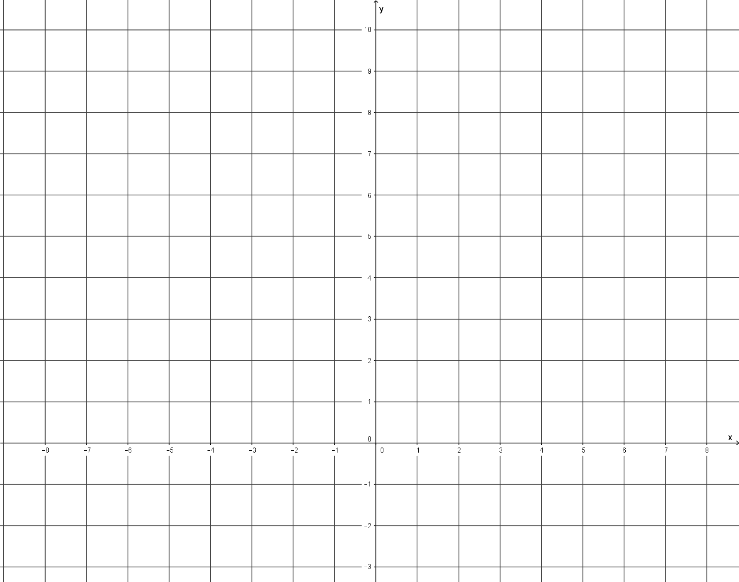
Eg. Graph the equation y = x²
x | -3 | -2 | -1 | 0 | 1 | 2 | 3
y
4
1
0
4
9
9
1
This gives us the coordinates that we can graph.
(-3, 9), (-2, 4), (-1, 1), (0, 0), (1, 1), (2, 4), (3, 9)
y
10
9
8
7
6
5
4
3
2
1
0
1
2
3
-10 -9 -8 -6 -5 -4 -3 -2 -1 0 1 2 3 4 5 6 7 8 9
X

Slide 24
Eg. Graph the equation y = x²
x | -3 | -2 | -1 | 0 | 1 | 2 | 3
y
4
1
0
4
9
9
1
This gives us the coordinates that we can graph.
(-3, 9), (-2, 4), (-1, 1), (0, 0), (1, 1), (2, 4), (3, 9)
y
10
9
8
7
6
5
4
3
2
1
0
1
2
3
-10 -9 -8 -6 -5 -4 -3 -2 -1 0 1 2 3 4 5 6 7 8 9
X

Slide 25
Eg. Graph the equation y = x²
x | -3 | -2 | -1 | 0 | 1 | 2 | 3
y
4
1
0
4
9
9
1
This gives us the coordinates that we can graph.
(-3, 9), (-2, 4), (-1, 1), (0, 0), (1, 1), (2, 4), (3, 9)
y
y
10
9
8
7
6
5
4
3
2
1
0
1
2
3
-10 -9 -8 -6 -5 -4 -3 -2 -1 0 1 2 3 4 5 6 7 8 9
X

Slide 26
Eg. Graph the equation y = x²
x | -3 | -2 | -1 | 0 | 1 | 2 | 3
y
4
1
0
4
9
9
1
This gives us the coordinates that we can graph.
(-3, 9), (-2, 4), (-1, 1), (0, 0), (1, 1), (2, 4), (3, 9)
y
10
9
8
7
6
5
4
3
2
1
0
1
2
3
-10 -9 -8 -6 -5 -4 -3 -2 -1 0 1 2 3 4 5 6 7 8 9
X

Slide 27
Eg. Graph the equation y = x²
x | -3 | -2 | -1 | 0 | 1 | 2 | 3
y
4
1
0
4
9
9
1
This gives us the coordinates that we can graph.
(-3, 9), (-2, 4), (-1, 1), (0, 0), (1, 1), (2, 4), (3, 9)
y
10
9
8
7
6
5
4
3
2
1
0
1
2
3
-10 -9 -8 -6 -5 -4 -3 -2 -1 0 1 2 3 4 5 6 7 8 9
X

Slide 28
Eg. Graph the equation y = x²
x | -3 | -2 | -1 | 0 | 1 | 2 | 3
y
4
1
0
4
9
9
1
This gives us the coordinates that we can graph.
(-3, 9), (-2, 4), (-1, 1), (0, 0), (1, 1), (2, 4), (3, 9)
y
10
9
8
7
6
5
4
3
2
1
0
1
2
3
-10 -9 -8 -6 -5 -4 -3 -2 -1 0 1 2 3 4 5 6 7 8 9
X

Slide 29
Eg. Graph the equation y = x²
x | -3 | -2 | -1 | 0 | 1 | 2 | 3
y
4
1
0
4
9
9
1
This gives us the coordinates that we can graph.
(-3, 9), (-2, 4), (-1, 1), (0, 0), (1, 1), (2, 4), (3, 9)
y
10
9
8
7
6
5
4
3
2
1
0
1
2
3
-10 -9 -8 -6 -5 -4 -3 -2 -1 0 1 2 3 4 5 6 7 8 9
X

Slide 30
Eg. Graph the equation y = x²
x | -3 | -2 | -1 | 0 | 1 | 2 | 3
y
4
1
0
4
9
9
1
This gives us the coordinates that we can graph.
(-3, 9), (-2, 4), (-1, 1), (0, 0), (1, 1), (2, 4), (3, 9)
y
10
9
8
7
6
5
4
3
2
1
0
1
2
3
-10 -9 -8 -6 -5 -4 -3 -2 -1 0 1 2 3 4 5 6 7 8 9
X

Slide 31
Eg. Graph the equation y = x²
x | -3 | -2 | -1 | 0 | 1 | 2 | 3
y
4
1
0
4
9
9
1
This gives us the coordinates that we can graph.
(-3, 9), (-2, 4), (-1, 1), (0, 0), (1, 1), (2, 4), (3, 9)
y
10
9
8
7
6
5
4
3
2
1
0
1
2
3
-10 -9 -8 -6 -5 -4 -3 -2 -1 0 1 2 3 4 5 6 7 8 9
X

Slide 32
Eg. Graph the equation y = x²
x | -3 | -2 | -1 | 0 | 1 | 2 | 3
y
4
1
0
4
9
9
1
This gives us the coordinates that we can graph.
(-3, 9), (-2, 4), (-1, 1), (0, 0), (1, 1), (2, 4), (3, 9)
y
10
9
8
7
6
5
4
3
2
1
0
1
2
3
Now join the dots
-10 -9 -8 -6 -5 -4 -3 -2 -1 0 1 2 3 4 5 6 7 8 9
X

Slide 33
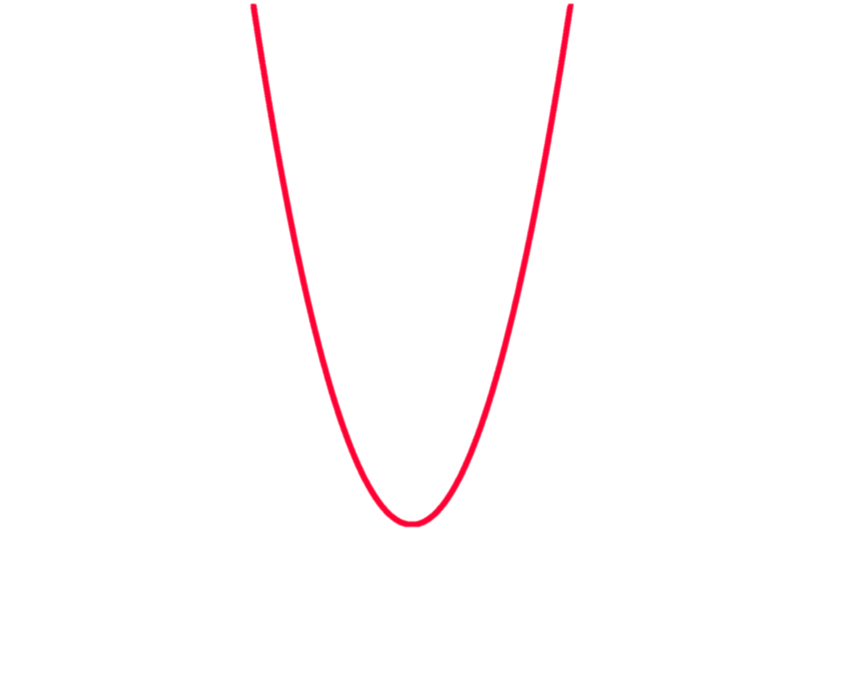
Eg. Graph the equation y = x²
x | -3 | -2 | -1 | 0 | 1 | 2 | 3
y
4
1
0
4
9
9
1
This gives us the coordinates that we can graph.
(-3, 9), (-2, 4), (-1, 1), (0, 0), (1, 1), (2, 4), (3, 9)
y
10
9
8
7
6
5
4
3
2
1
0
1
2
3
Now join the dots
-10 -9 -8 -6 -5 -4 -3 -2 -1 0 1 2 3 4 5 6 7 8 9
X

Slide 34
Eg. Graph the equation y = x²
x | -3 | -2 | -1 | 0 | 1 | 2 | 3
y
4
1
0
4
9
9
1
This gives us the coordinates that we can graph.
(-3, 9), (-2, 4), (-1, 1), (0, 0), (1, 1), (2, 4), (3, 9)
y
10
9
8
7
6
5
4
3
2
1
0
1
2
3
Where the graph turns is called the turning point or vertex
-10 -9 -8 -6 -5 -4 -3 -2 -1 0 1 2 3 4 5 6 7 8 9
X

Slide 35
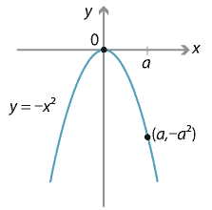
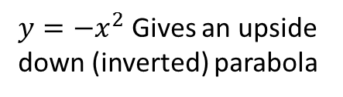
$y=−x^{2}$ Gives an upside down (inverted) parabola

Slide 36
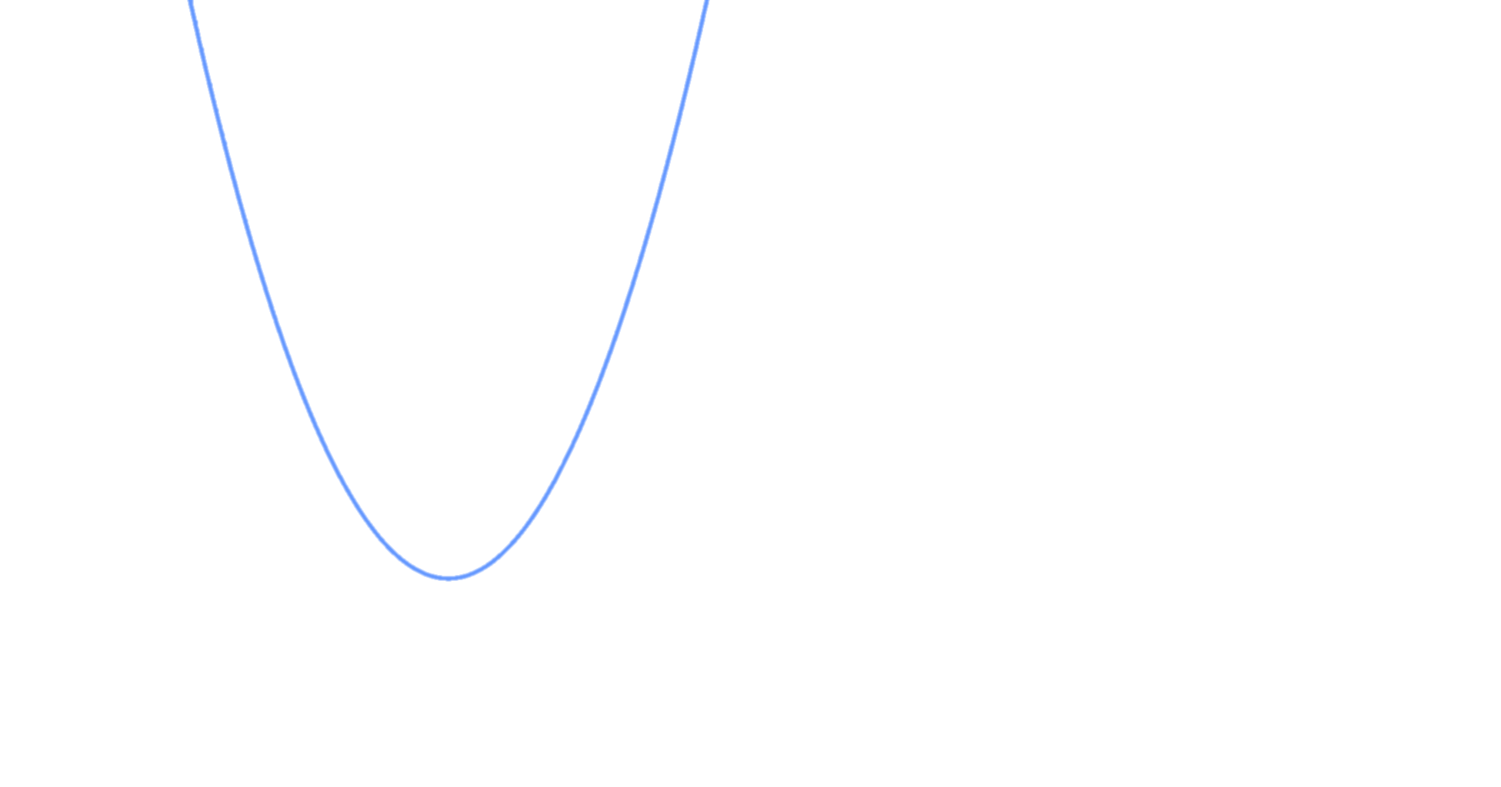
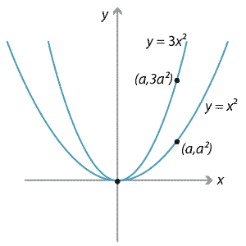

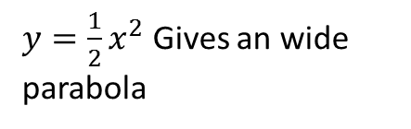
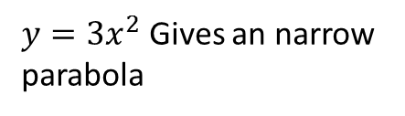
$y=3x^{2}$ Gives an narrow parabola
$$y=\frac{1}{2}x^{2}$$
$y=\frac{1}{2}x^{2}$ Gives an wide parabola

Slide 37
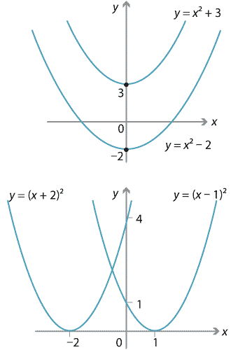
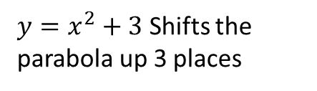
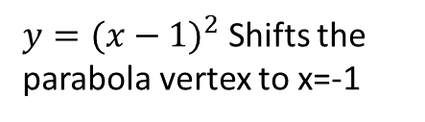
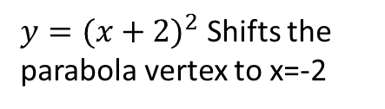
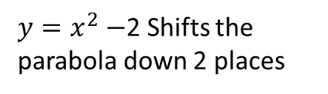
$y=x^{2}+3$ Shifts the parabola up 3 places
$y=x^{2}−$2 Shifts the parabola down 2 places
$y={(x+2)}^{2}$ Shifts the parabola vertex to x=-2
$y={(x−1)}^{2}$ Shifts the parabola vertex to x=-1

Slide 39
Summary of steps
Create a table of x values (try x= -3 up to x=3)
Use the formula to find the y values and create coordinates
Plot the coordinates and join the coordinates together.
Use the provided Graph paper to complete exercise 4.6 on page 55
Make sure you place your name on your graph paper as it will be collected (to check your understanding)

Slide 40
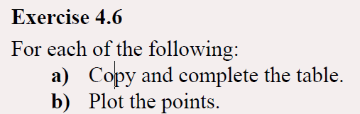
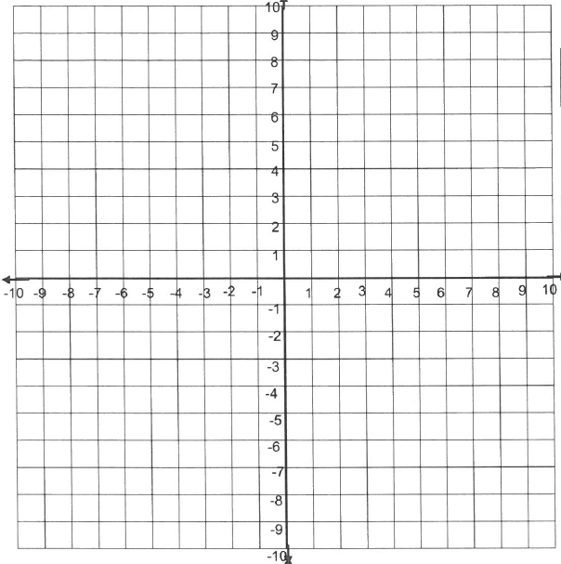
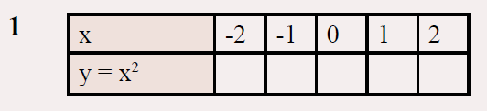
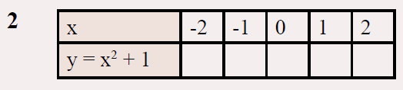
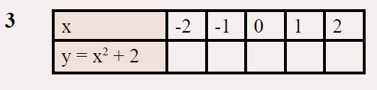
Page 55

Slide 41
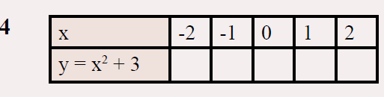
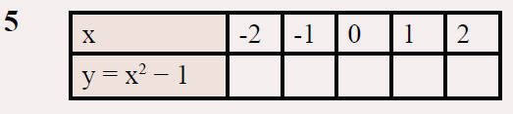
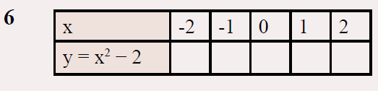
Page 55

Slide 42
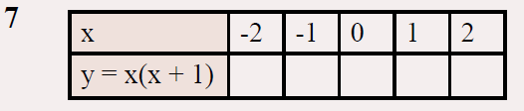
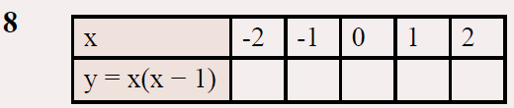
Page 55

